Slide 1
Module #8: Transfer Path Analysis

Slide 2
TPA: Outline
Introduction to TPA
Source-Path-Receiver Framework
Theory for TPA Methods
Classical TPA
Component-based TPA

Slide 3
Introduction to TPA

Slide 4
What’s the Point of TPA?
We want a modular technique to understand noise and vibration in systems
How is vibration energy moving in the system?
Troubleshooting undesired vibration responses:
System sensitivities?
High forces?
Key contributors?
What happens if I change the system configuration?

Slide 5
What’s the Point of TPA?
We want a modular technique to understand noise and vibration in systems
How is vibration energy moving in the system?
Troubleshooting undesired vibration responses:
System sensitivities?
High forces?
Key contributors?
What happens if I change the system configuration?

Slide 6
What’s the Point of TPA?
We want a modular technique to understand noise and vibration in systems
How is vibration energy moving in the system?
Troubleshooting undesired vibration responses:
System sensitivities?
High forces?
Key contributors?
What happens if I change the system configuration?

Slide 7
What’s the Point of TPA?
We want a modular technique to understand noise and vibration in systems
How is vibration energy moving in the system?
Troubleshooting undesired vibration responses:
System sensitivities?
High forces?
Key contributors?
What happens if I change the system configuration?

Slide 8
What’s the Basic Concept?
TPA takes a holistic perspective, by combining the responses, forces, and underlying physics for the noise and vibration
Noise and Vibration Responses
Modal Properties
Forces
The vibration data we care about

Slide 9
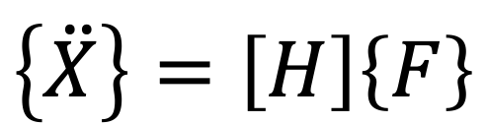
Describing Noise and Vibration with Physics
We want to define all the elements in the equation of motion for our system
$$\left\{\ddot{X}\right\}=\left[H\right]\left\{F\right\}$$

Slide 10
Describing Noise and Vibration with Physics
We want to define all the elements in the equation of motion for our system
Characterized by operating tests
$$\left\{\ddot{X}\right\}=\left[H\right]\left\{F\right\}$$

Slide 11
Describing Noise and Vibration with Physics
We want to define all the elements in the equation of motion for our system
Characterized by operating tests
$$\left\{\ddot{X}\right\}=\left[H\right]\left\{F\right\}$$
Estimated with lab (e.g., modal) tests or numerical models

Slide 12
Describing Noise and Vibration with Physics
We want to define all the elements in the equation of motion for our system
Characterized by operating tests
$$\left\{\ddot{X}\right\}=\left[H\right]\left\{F\right\}$$
Indirectly estimate the forces in most situations
Estimated with lab (e.g., modal) tests or numerical models

Slide 13
Describing Noise and Vibration with Physics
We want to define all the elements in the equation of motion for our system
Characterized by operating tests
$$\left\{\ddot{X}\right\}=\left[H\right]\left\{F\right\}$$
Indirectly estimate the forces in most situations
Estimated with lab (e.g., modal) tests or numerical models
Three different techniques

Slide 14

Lingo Soup with TPA
Pseudo Forces
Free-velocity Forces
Receivers
Hybrid TPA
Source
Contact Forces
Paths
Blocked Forces
Classical TPA
Target
Contribution Analysis
Indicators
Equivalent Source
Component Based TPA
Virtual Prototype

Slide 15
Different Types of TPA
Transfer Path Analysis
Classical TPA
Component Based TPA
Operational TPA
Direct Force Measurement
Mount Stiffness Method
Matrix Inversion Method
Free Velocity
Blocked Forces
In-situ Forces
Equivalent Source
Pseudo Forces
Matrix Inversion Method with Transmissibility Functions
Other Methods

Slide 16
Different Types of TPA
Transfer Path Analysis
Classical TPA
Component Based TPA
Operational TPA
Direct Force Measurement
Mount Stiffness Method
Matrix Inversion Method
Free Velocity
Blocked Forces
In-situ Forces
Equivalent Source
Pseudo Forces
Matrix Inversion Method with Transmissibility Functions
Other Methods
Left out for brevity

Slide 17
Different Types of TPA
Transfer Path Analysis
Classical TPA
Component Based TPA
Operational TPA
Direct Force Measurement
Mount Stiffness Method
Matrix Inversion Method
Free Velocity
Blocked Forces
In-situ Forces
Equivalent Source
Pseudo Forces
Matrix Inversion Method with Transmissibility Functions
Other Methods
Left out for brevity
Troubleshooting
Evaluating configuration changes

Slide 18
Source-Path-Receiver Framework

Slide 19
Source-Path-Receiver Framework
Coupling
Propulsion System
Payload
Payload

Slide 20
Source-Path-Receiver Framework
Receiver – vibration on important components in the payload
Coupling
Propulsion System
Payload
Payload

Slide 21
Source-Path-Receiver Framework
Receiver – vibration on important components in the payload
Source – forces acting on the system
Coupling
Propulsion System
Payload
Payload

Slide 22
Source-Path-Receiver Framework
Receiver – vibration on important components in the payload
Source – forces acting on the system
Coupling
Propulsion System
Payload
Payload
Path – how energy moves in the system

Slide 23



Source-Path-Receiver Framework
Receiver – vibration on important components in the payload
$$\left\{\ddot{X}\right\}−system responses$$
Source – forces acting on the system
$$\left\{F\right\}− forces$$
Coupling
Propulsion System
Payload
Payload
Path – how energy moves in the system
$$\left[H\right] −system FRFs$$

Slide 24
Source-Path-Receiver Framework
TPA groups the sources, paths, and receivers into sub-components of the system
Source Component
Path
Receiver Component
Coupling
Propulsion System
Payload
Payload

Slide 25
Source-Path-Receiver Framework – The Rules
Any source-path-receiver breakdown is valid as long as it follows some simple rules – choose what is most convenient
The receiver cannot generate noise and vibration on its own
The source is the only thing that generates noise and vibration energy
We don’t care about the noise and vibration response on the source

Slide 26
Source-Path-Receiver Framework – The Rules
Any source-path-receiver breakdown is valid as long as it follows some simple rules – choose what is most convenient
The receiver cannot generate noise and vibration on its own
The source is the only thing that generates noise and vibration energy
We don’t care about the noise and vibration response on the source

Slide 27
Source-Path-Receiver Framework – The Rules
Any source-path-receiver breakdown is valid as long as it follows some simple rules – choose what is most convenient
The receiver cannot generate noise and vibration on its own
The source is the only thing that generates noise and vibration energy
We don’t care about the noise and vibration response on the source

Slide 28
Source-Path-Receiver Framework – The Rules
Any source-path-receiver breakdown is valid as long as it follows some simple rules – choose what is most convenient
The receiver cannot generate noise and vibration on its own
The source is the only thing that generates noise and vibration energy
We don’t care about the noise and vibration response on the source

Slide 29
Types of TPA

Slide 30



TPA and One-way FBS
$$x_{k}^{rocket}=h_{ki}^{rocket}f_{i}^{propulsion}$$
Coupling
$$Excitation: f_{i}^{propulsion}$$
Propulsion System
Payload
Payload
$$Response on Payload:x_{k}^{rocket}$$
$$Interface between components: DOF j$$

Slide 31
TPA and One-way FBS
$$x_{k}^{rocket}=h_{kj}^{payload}{\left(h_{jj}^{payload}+h_{jj}^{propulsion}\right)}^{−1}h_{ji}^{propulsion}f_{i}^{propulsion}$$
Coupling
$$Excitation: f_{i}^{propulsion}$$
Propulsion System
Payload
Payload
$$Response on Payload:x_{k}^{rocket}$$
$$Interface between components: DOF j$$

Slide 32
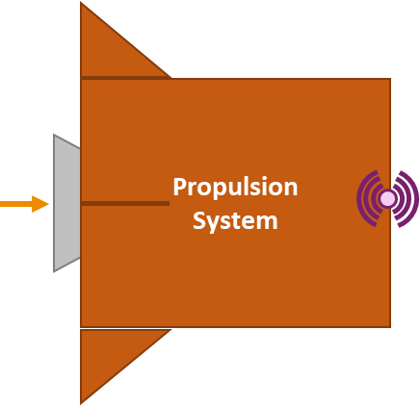
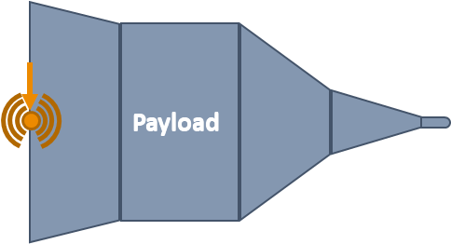
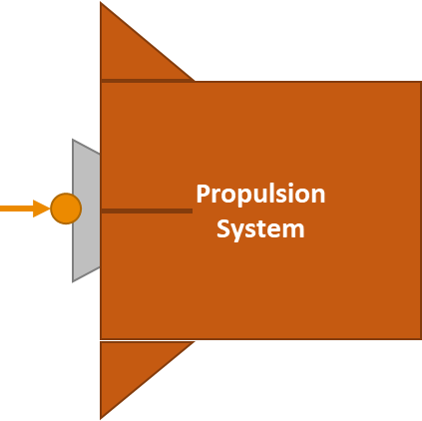
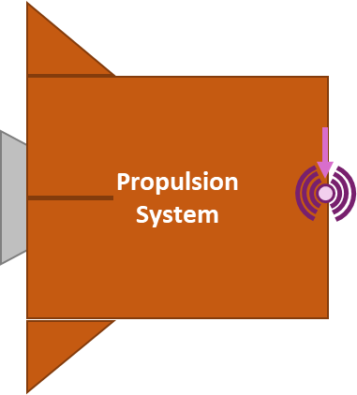
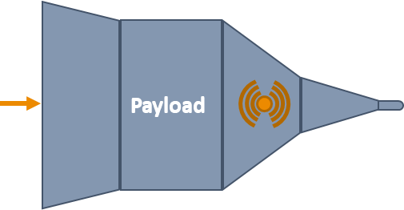





TPA and One-way FBS
$$x_{k}^{rocket}=h_{kj}^{payload}{\left(h_{jj}^{payload}+h_{jj}^{propulsion}\right)}^{−1}h_{ji}^{propulsion}f_{i}^{propulsion}$$
Propulsion System Only Information
Payload Only Information
$$h_{ji}^{propulsion}$$
$$h_{jj}^{payload}$$
$$h_{jj}^{propulsion}$$
$$f_{i}^{propulsion}$$
$$h_{kj}^{payload}$$

Slide 33
TPA and One-way FBS
$$x_{k}^{rocket}=h_{kj}^{payload}{\left(h_{jj}^{payload}+h_{jj}^{propulsion}\right)}^{−1}h_{ji}^{propulsion}f_{i}^{propulsion}$$
Propulsion System Only Information
Payload Only Information
$$h_{ji}^{propulsion}$$
$$h_{jj}^{payload}$$
$$h_{jj}^{propulsion}$$
$$f_{i}^{propulsion}$$
$$h_{kj}^{payload}$$

Slide 34
TPA and One-way FBS
$$x_{k}^{rocket}=h_{kj}^{payload}{\left(h_{jj}^{payload}+h_{jj}^{propulsion}\right)}^{−1}h_{ji}^{propulsion}f_{i}^{propulsion}$$
Propulsion System Only Information
Payload Only Information
$$h_{ji}^{propulsion}$$
$$h_{jj}^{payload}$$
$$h_{jj}^{propulsion}$$
$$f_{i}^{propulsion}$$
$$h_{kj}^{payload}$$

Slide 35
TPA and One-way FBS
$$x_{k}^{rocket}=h_{kj}^{payload}{\left(h_{jj}^{payload}+h_{jj}^{propulsion}\right)}^{−1}h_{ji}^{propulsion}f_{i}^{propulsion}$$
Propulsion System Only Information
Payload Only Information
$$h_{ji}^{propulsion}$$
$$h_{jj}^{payload}$$
$$h_{jj}^{propulsion}$$
$$f_{i}^{propulsion}$$
$$h_{kj}^{payload}$$

Slide 36
TPA and One-way FBS
$$x_{k}^{rocket}=h_{kj}^{payload}{\left(h_{jj}^{payload}+h_{jj}^{propulsion}\right)}^{−1}h_{ji}^{propulsion}f_{i}^{propulsion}$$
Propulsion System Only Information
Payload Only Information
$$h_{ji}^{propulsion}$$
$$h_{jj}^{payload}$$
$$h_{jj}^{propulsion}$$
$$f_{i}^{propulsion}$$
$$h_{kj}^{payload}$$

Slide 37
TPA and One-way FBS
$$x_{k}^{rocket}=h_{kj}^{payload}{\left(h_{jj}^{payload}+h_{jj}^{propulsion}\right)}^{−1}h_{ji}^{propulsion}f_{i}^{propulsion}$$
Propulsion System Only Information
Payload Only Information
$$h_{ji}^{propulsion}$$
$$h_{jj}^{payload}$$
$$h_{jj}^{propulsion}$$
$$f_{i}^{propulsion}$$
$$h_{kj}^{payload}$$

Slide 38
TPA and One-way FBS
$$x_{k}^{rocket}=h_{kj}^{payload}{\left(h_{jj}^{payload}+h_{jj}^{propulsion}\right)}^{−1}h_{ji}^{propulsion}f_{i}^{propulsion}$$
Coupling
$$Excitation: f_{i}^{propulsion}$$
Propulsion System
Payload
Payload
$$Response on Payload:x_{k}^{rocket}$$
$$Interface between components: DOF j$$

Slide 39
TPA and One-way FBS – Force Reconstruction
$$x_{k}^{rocket}=h_{kj}^{payload}{\left(h_{jj}^{payload}+h_{jj}^{propulsion}\right)}^{−1}h_{ji}^{propulsion}f_{i}^{propulsion}$$
Coupling
$$Excitation: f_{i}^{propulsion}$$
Propulsion System
Payload
Payload
$$Response on Payload:x_{k}^{rocket}$$
$$Interface between components: DOF j$$
Estimate the actual forces acting on the rocket

Slide 40
TPA and One-way FBS – Classical TPA
$$x_{k}^{rocket}=h_{kj}^{payload}{\left(h_{jj}^{payload}+h_{jj}^{propulsion}\right)}^{−1}h_{ji}^{propulsion}f_{i}^{propulsion}$$
Coupling
$$Excitation: f_{i}^{propulsion}$$
Propulsion System
Payload
Payload
$$Response on Payload:x_{k}^{rocket}$$
$$Interface between components: DOF j$$
Estimate the coupling force that is acting on the payload

Slide 41



TPA and One-way FBS – Classical TPA
$$x_{k}^{rocket}=h_{kj}^{payload}{\left(h_{jj}^{payload}+h_{jj}^{propulsion}\right)}^{−1}h_{ji}^{propulsion}f_{i}^{propulsion}$$
$$x_{k}^{rocket}=h_{kj}^{payload}f_{j}^{payload}$$
$$Coupling Force: f_{j}^{payload}$$
Payload
Payload
$$Response on Payload:x_{k}^{rocket}$$
Estimate the coupling force that is acting on the payload

Slide 42
TPA and One-way FBS – Component Based TPA
$$x_{k}^{rocket}=h_{kj}^{payload}{\left(h_{jj}^{payload}+h_{jj}^{propulsion}\right)}^{−1}h_{ji}^{propulsion}f_{i}^{propulsion}$$
Coupling
$$Excitation: f_{i}^{propulsion}$$
Propulsion System
Payload
Payload
$$Response on Payload:x_{k}^{rocket}$$
$$Interface between components: DOF j$$
Estimate forces that influence the propulsion system in the same way as the rocket motor force

Slide 43


TPA and One-way FBS – Component Based TPA
$$x_{k}^{rocket}=h_{kj}^{payload}{\left(h_{jj}^{payload}+h_{jj}^{propulsion}\right)}^{−1}h_{ji}^{propulsion}f_{i}^{propulsion}$$
$$x_{k}^{rocket}=h_{kj}^{payload}{\left(h_{jj}^{payload}+h_{jj}^{propulsion}\right)}^{−1}x_{j}^{propulsion}$$
$$Free Response at Coupling: x_{j}^{propulsion}$$
Coupling
Propulsion System
Payload
Payload
$$Response on Payload:x_{k}^{rocket}$$
$$Interface between components: DOF j$$
Estimate forces that influence the propulsion system in the same way as the rocket motor force

Slide 44

TPA and One-way FBS – Component Based TPA
$$x_{k}^{rocket}=h_{kj}^{payload}{\left(h_{jj}^{payload}+h_{jj}^{propulsion}\right)}^{−1}h_{ji}^{propulsion}f_{i}^{propulsion}$$
$$x_{k}^{rocket}=h_{kj}^{payload}{\left(h_{jj}^{payload}+h_{jj}^{propulsion}\right)}^{−1}x_{j}^{propulsion}$$
$$Free Response at Coupling: x_{j}^{propulsion}$$
$$x_{j}^{propulsion}=h_{j…}^{propulsion}f_{…}^{propulsion}$$
Coupling
Propulsion System
Payload
Payload
$$Response on Payload:x_{k}^{rocket}$$
$$Interface between components: DOF j$$
Estimate forces that influence the propulsion system in the same way as the rocket motor force

Slide 45
TPA and One-way FBS – Component Based TPA
$$x_{k}^{rocket}=h_{kj}^{payload}{\left(h_{jj}^{payload}+h_{jj}^{propulsion}\right)}^{−1}h_{ji}^{propulsion}f_{i}^{propulsion}=h_{kj}^{payload}{\left(h_{jj}^{payload}+h_{jj}^{propulsion}\right)}^{−1}h_{jz}^{propulsion}f_{z}^{propulsion}$$
$$x_{k}^{rocket}=h_{ki}^{rocket}f_{i}^{propulsion}=h_{kz}^{rocket}f_{z}^{propulsion}$$
Substructuring explains why component based TPA works but no substructuring is required in the process
The estimated forces in component based TPA are representative of the actual forces acting on the source component
The estimated forces in component based TPA are independent of the receiver component

Slide 46
Summary
TPA combines many elements of structural dynamics to understand the noise and vibration in systems
Classical TPA:
Typically focused on troubleshooting noise and vibration issues
Estimating the coupling forces between the source and receiver
Component based TPA
Estimating a pseudo-force that is mathematically equivalent to the actual source
Pseudo-forces are independent of the receiver system
Makes it possible to estimate noise and vibration responses on untested system configurations
A major challenge with TPA is the force estimation step

Slide 47
Next Up: Virtual Point Transformation

